Slide 1
Qualcomm VisionX Object Detection Model Development
Utilizing YOLOv5 for Real-Time Object Detection
By
SAMUELSON G

Slide 2
Objective
Develop an object detection model that can accurately detect, classify, and localize multiple objects within an image or video frame.

Slide 3
Key Requirements
High Precision: Minimize false positives and false negatives.
01
Real-Time Processing: Capable of processing images or video in real-time or near real-time.
02
Diverse Environments: Handle different lighting, angles, and object occlusions.
03

Slide 4
Applications
Real-World Scenarios:
Surveillance: Enhancing security and monitoring.
Autonomous Driving: Ensuring safety and navigation.
Retail Automation: Streamlining inventory management and customer service.

Slide 5
Model Overview
Clone repo: YOLOv5
Key Features:
Fast and accurate object detection.
Capable of detecting multiple objects in a single frame.

Slide 6


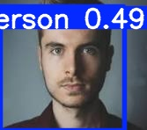
Image Example
Object Detection Example

Slide 7
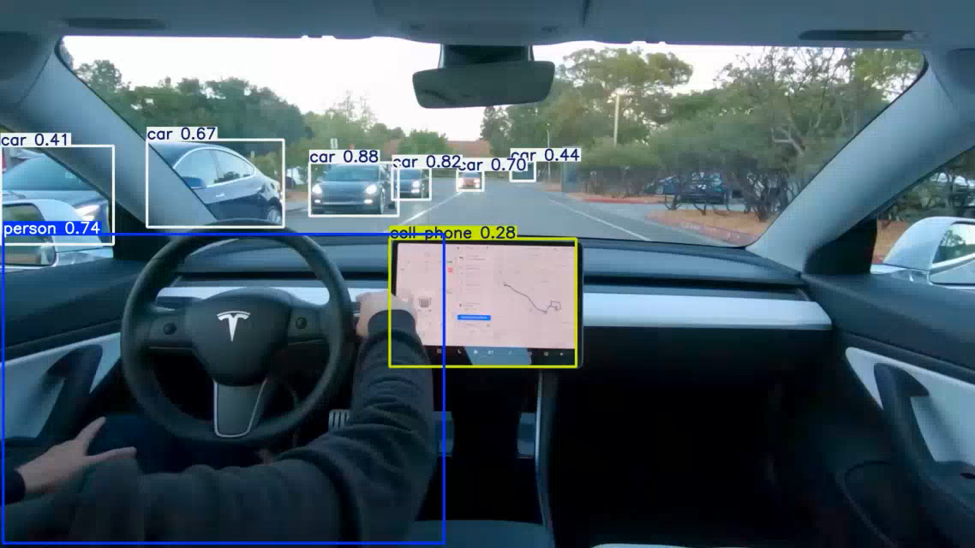
Video Demonstration
Real-Time Object Detection in Action

Slide 8
Challenges and Solutions
Challenges:
Variability in lighting and object occlusions.
Real-time processing demands.
Solutions:
Training on diverse datasets.
Optimizing model parameters for speed and accuracy.

Slide 9
Conclusion
Summary: The YOLOv5 repo and its model effectively meets the objectives of detecting, classifying, and localizing objects in real-time across various environments.
Future Work: Potential improvements and expansions of the model capabilities.

